Slide 1
UNIT-II
LOGIC FAMILIES

Slide 2
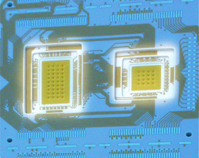
Integration Levels
Gate/transistor ratio is roughly 1/10
SSI(Small Scale Integration) < 12 gates/chip
MSI(Medium Scale Integration) < 100 gates/chip
LSI(Large Scale Integration) …1K gates/chip
VLSI(Very Large Scale Integration )…10K gates/chip
ULSI(Ultra Large Scale Integration )…100K gates/chip
GSI(Giant Scale Integration ) …1Meg gates/chip

Slide 3
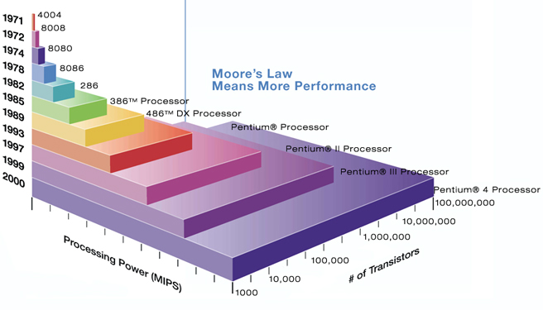
Moore’s law
A prediction made by Moore (a co-founder of Intel) in 1965:
“a number of transistors to double every 2 years.”

Slide 4
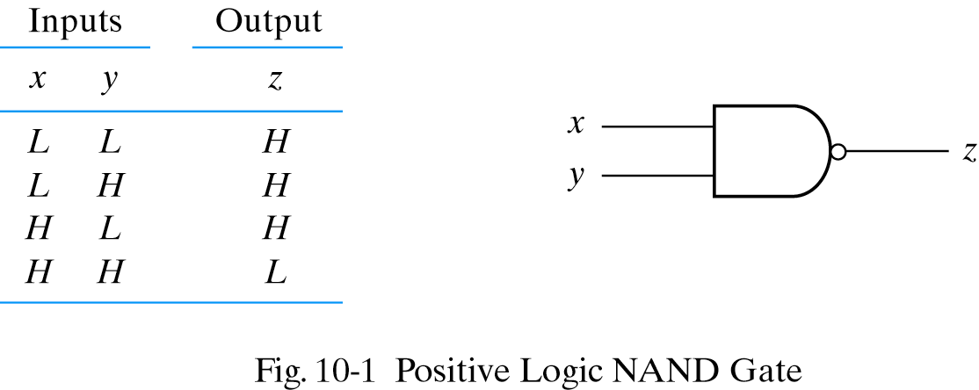
Positive logic
Positive logic: H is set to be binary 1
L is set to be binary 0

Slide 5
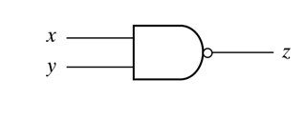
Negative logic
Negative logic: L is set to be binary 1
H is set to be binary 0
INPUT |  | OUTPUT
X | Y | Z
H | H | L
H | L | L
L | H | L
L | L | H

Slide 6
Digital IC specifications (or) characteristics of digital logic families
The most useful specifications or feature to be concerned of IC logic families:
Threshold voltage
Propagation delay
Power dissipation
Fan-in
Fan-out
Voltage and current requirement
Noise Margin
Operating temperature
Speed power product

Slide 7
Digital IC Specifications
Threshold voltage: The voltage at the input of a gate which causes a change in the state of the output from one logic level to the other.
Propagation delay: Time interval b/w the application of an i/p pulse & occurrence of resulting o/p pulse.
The average transition-delay time for the signal to propagate from input to output when the binary signal changes in value.
A pulse through a gate takes a certain amount of time to propagate from input to output. This interval of time is known as the propagation delay of the gate.
Average transition delay time tpd = (tPLH + tPHL) /2

Slide 8
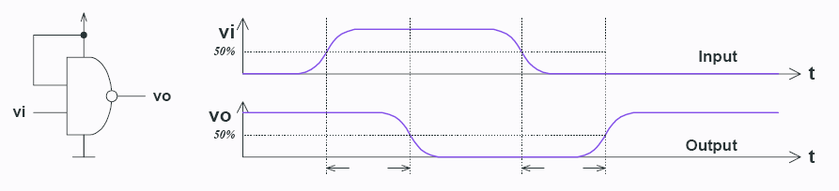
Logic families: propagation delay
T_{PD,HL}
T_{PD,LH}
T_{PD,HL} – input-to-output propagation delay from HI to LO output
T_{PD,LH} – input-to-output propagation delay from LO to HI output

Slide 9
Power dissipation
Every logic gate draws some current from the supply for its operation
The current drawn in HIGH state is different from that drawn in LOW state.
Power dissipation of a logic gate is the power required by the gate to operate with 50% duty cycle at specified frequency.
The power needed by the gate expressed in mW
Pd=Vcc*Icc(avg)/n. where Vcc is the gate supply voltage, Icc(avg) is the average current drawn from the supply by the entire IC, n is the number of gates in the IC.
Icc(avg) = (ICCH+ICCL)/2
ICCH-current drawn by the IC when all the gates in the IC are in HIGH state,
ICCL-current drawn by the IC when all the gates in the IC are in LOW state,
Total power consumed by an IC is equal to the product of the power dissipated by each gate and the no. of gates in that IC.

Slide 10
Fan-in and Fan-out
Fan-in :The fan-in of a logic gate is defined as the number of inputs that the gate is designed to handle.
Fan-out: The number of standard loads can be connected to the output of the gate without degrading its normal operation. Sometimes the term loading is used
High state fan-out : the fan-out of the gate when its output is logic 1-driving gate sources current
Low state fan-out : the fan-out of the gate when its output is logic 0- driving gate sinks current
Actual fan out is smaller of these two numbers.

Slide 11
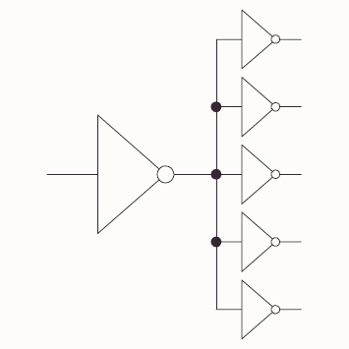
Logic families: fanout
Fanout: the maximum number of logic inputs (of the same logic family) that an output can drive reliably

Slide 12
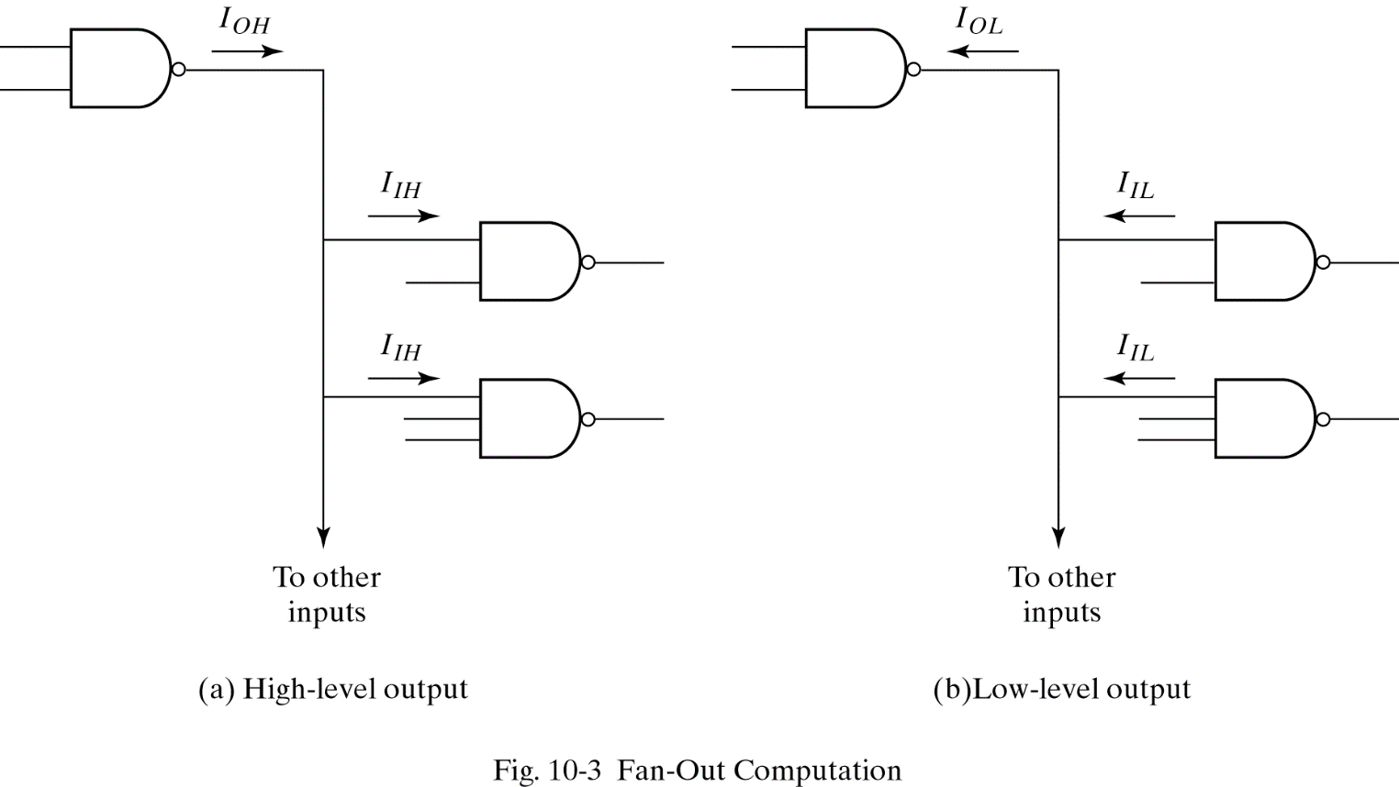
Computing fan-out

Slide 13
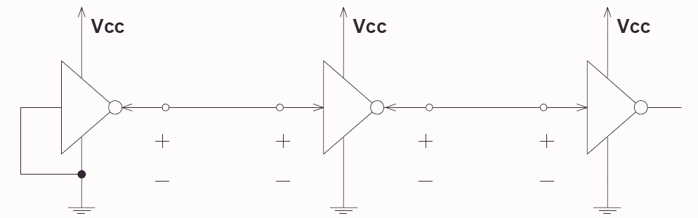
Logic families: Voltage levels
V_{OH}(min) – The minimum voltage level at an output in the logical “1” state under defined load conditions
V_{OL}(max) – The maximum voltage level at an output in the logical “0” state under defined load conditions
V_{IH}(min) – The minimum voltage required at an input to be recognized as “1” logical state
V_{IL}(max) – The maximum voltage required at an input that still will be recognized as “0” logical state
V_{OH}
V_{IH}
V_{OL}
V_{IL}
Notes:
These are: high-level output voltage (OH), low-level output voltage (OL), high-level input voltage (IH), low-level input voltage (IL)

Slide 14
Logic families: current requirements
I_{OH} – Current flowing into an output in the logical “1” state under specified load conditions
I_{OL} – Current flowing into an output in the logical “0” state under specified load conditions
I_{IH} – Current flowing into an input when a specified HI level is applied to that input
I_{IL} – Current flowing into an input when a specified LO level is applied to that input
I_{OH}
I_{IH}
I_{OL}
I_{IL}
V_{OH}
V_{IH}
V_{OL}
V_{IL}

Slide 15
Noise margin
The unwanted signals are referred to as noise
Noise margin is the maximum noise added to an input signal of a digital circuit that does not cause an undesirable change in the circuit output .
High state noise margin is the difference between the lowest possible high output and the minimum input voltage required for a HIGH.
Low state noise margin is the difference between the largest possible low output and the maximum input voltage required for a LOW.

Slide 16
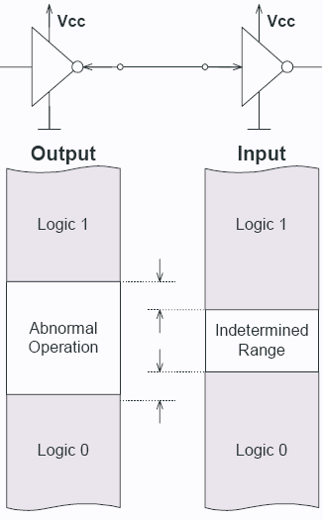
DC Noise margins
HI state noise margin:
V_{NH} = V_{OH}(min) – V_{IH}(min)
LO state noise margin:
V_{NL} = V_{IL}(max) – V_{OL}(max)
Noise margin:
V_{N} = min(V_{NH},V_{NL})
V_{NH}
V_{NL}

Slide 17
Digital IC Specifications
- operating temperature
The IC gates and other circuits are temperature sensitive.
They are designed to operate satisfactorily over a specified range of temperature.
Range for commercial application is 0֯ to70֯ C, industrial 0֯ to85֯ C and for military applications -55֯ to 125֯ C.
Speed power product
Multiply the gate propagation delay by the gate power dissipation
Smaller value is desirable. The smaller value gives better overall performance.
It has the units of energy and expressed in picco-joules
The IC has an average propagation delay of 10ns and an average power dissipation of 5mw, the speed power product is
10 ns*5mw=50*10^-12 watts-seconds= 50 picco-joules

Slide 18
Typical npn Transistor Parameters
Region | V_{BE} (V) | V_{CE} (V) | Current Relation
Cutoff | < 0.7 | Open circuit | I_{B}=I_{C}=0
Active | 0.7-0.8 | > 0.8 | I_{C} =h_{FE}I_{B}
Saturation | 0.8-0.9 | 0.2 | I_{B} ≥I_{C}/h_{FE}

Slide 19
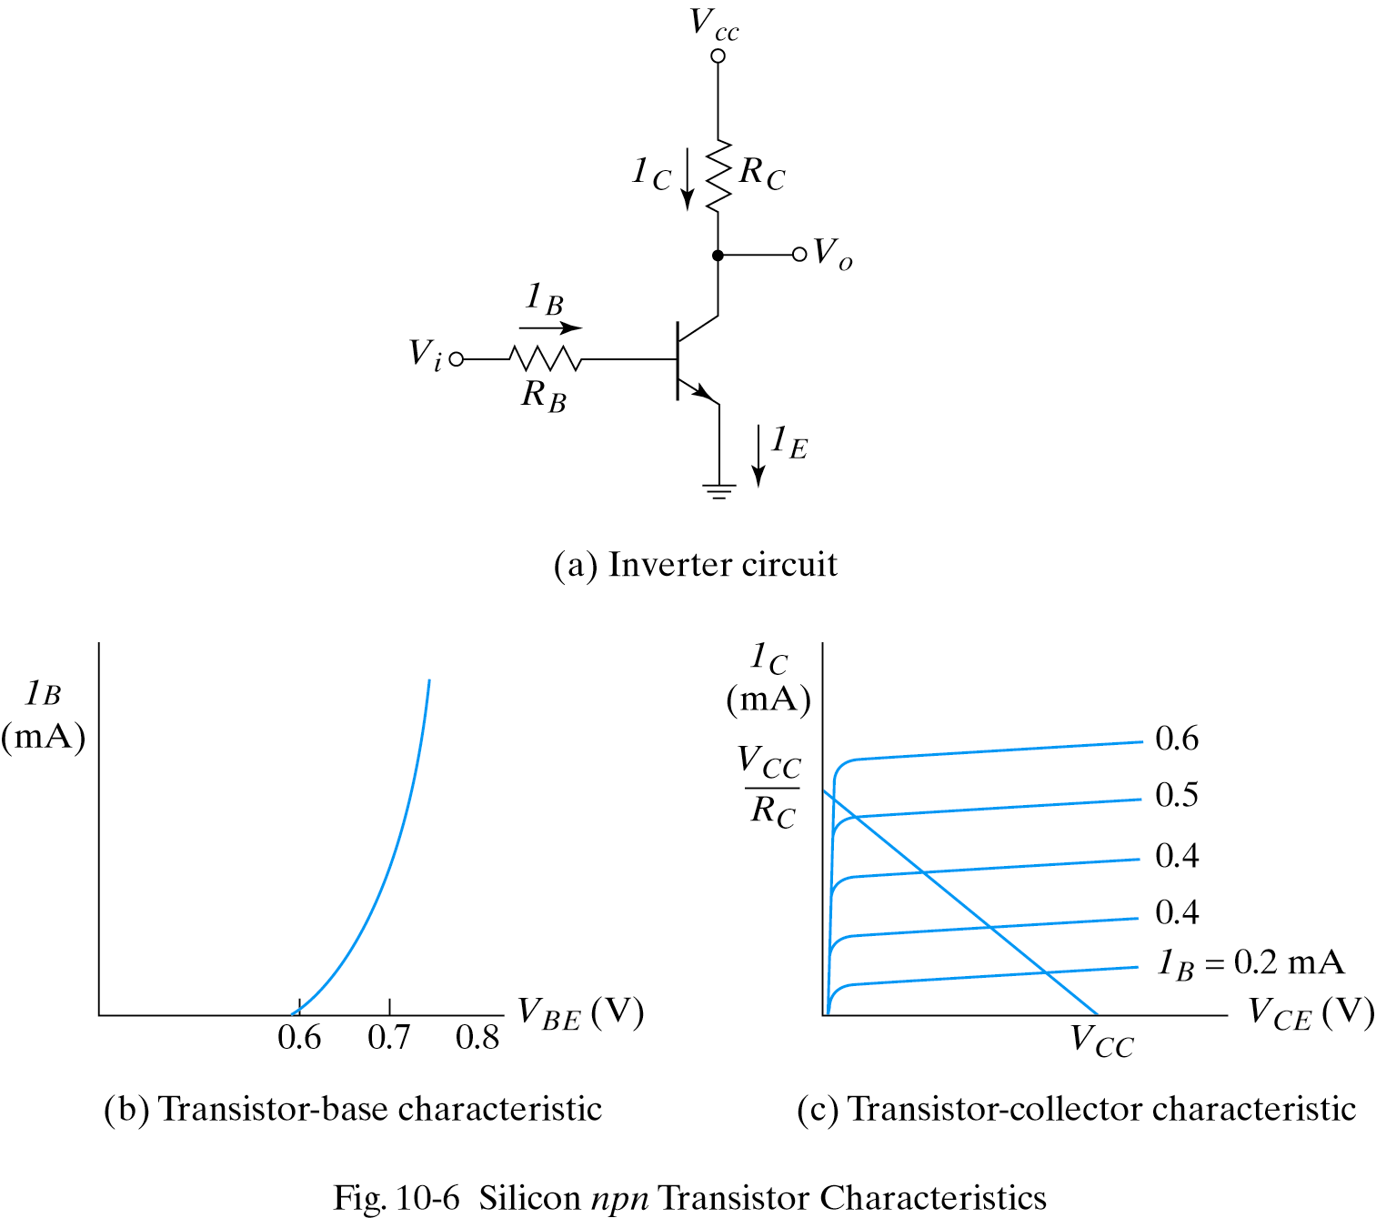
Feature of npn-type BJT

Slide 20
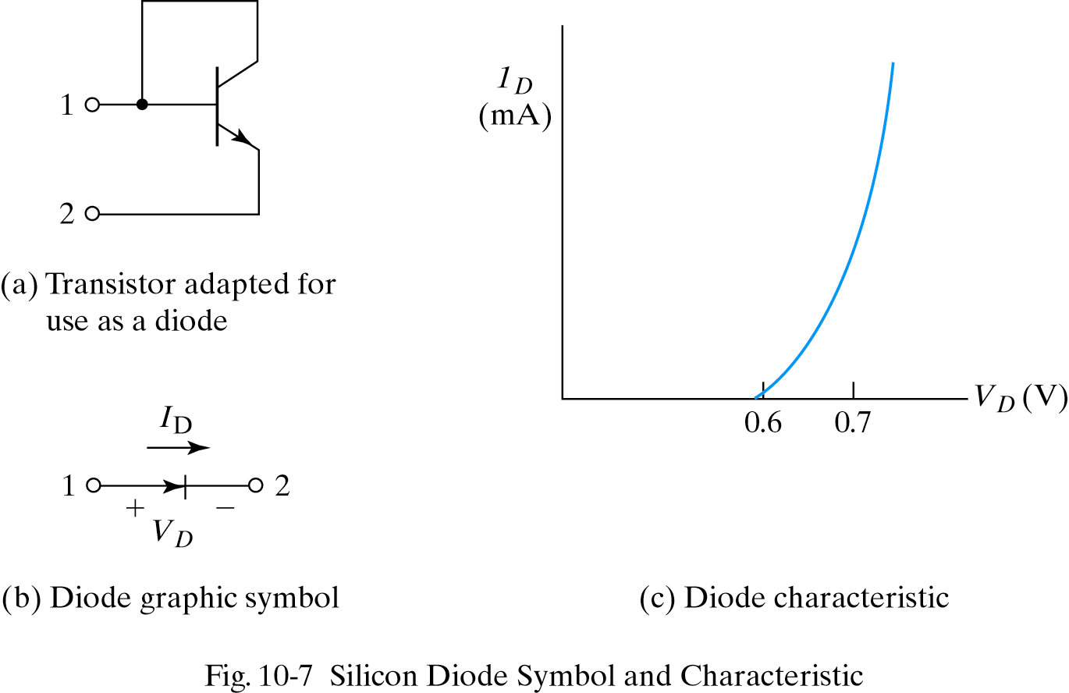
Diode – symbol and characteristic

Slide 21
IC digital logic families
IC digital logic families
RTL(Resistor-transistor logic）
DTL(Diode-transistor logic）
TTL(Transistor -transistor logic）
ECL(Emitter-coupled logic）
CMOS(Complementary Metal-oxide semiconductor）

Slide 22
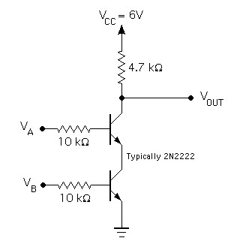

Resistor-Transistor Logic (RTL)
RTL NAND circuits
Transistor as a switch
can be cascaded
large power draw
=
A | B | NAND o/p
0 | 0 | 1
0 | 1 | 1
1 | 0 | 1
1 | 1 | 0
Notes:
RTL had economic advantage in that very few transistors were used. It was important when transistors were expensive to make (more expensive than resistors). Such times have long past.

Slide 23
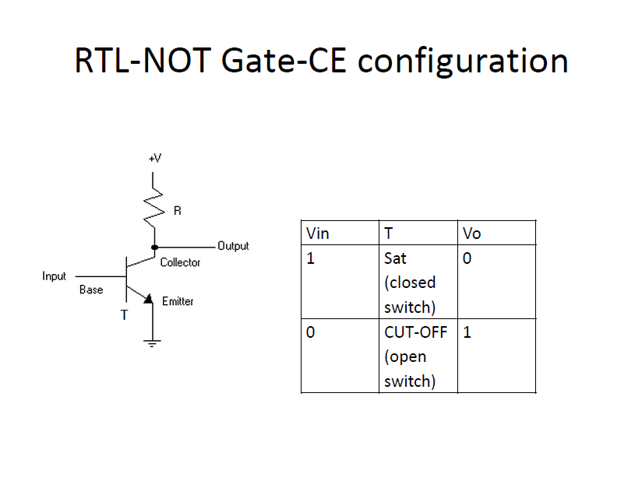

Slide 24
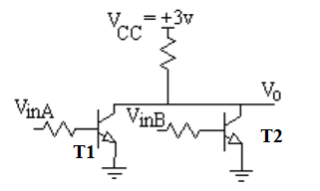
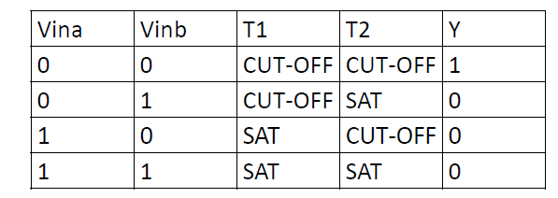
RTL--NOR

Slide 25
Resistor-Transistor Logic (RTL)
O/p voltage drops about 1v when the fan-out is 5
Power dissipation is about 12mw.
Propagation delay averages 25ns.

Slide 26
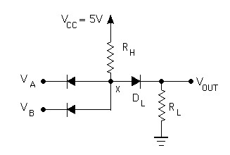

Diode Logic (DL)
simplest; does not scale
NOT not possible (need an active element)
A | B | AND o/p
0 | 0 | 0
0 | 1 | 0
1 | 0 | 0
1 | 1 | 1
=

Slide 27
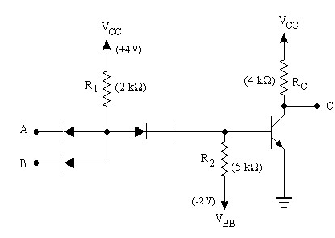
Diode-Transistor Logic (DTL)
essentially diode logic with transistor amplification
reduced power consumption
faster than RTL
=
A | B | NAND o/p
0 | 0 | 1
0 | 1 | 1
1 | 0 | 1
1 | 1 | 0
DL AND gate
inverter
Notes:
RTL had economic advantage in that very few transistors were used. It was important when transistors were expensive to make (more expensive than resistors). Such times have long past.

Slide 28
DTL-NAND
Input Diodes Da,Db,Dc conduct through resistor R, if the corresponding input is in the LOW state, while the corresponding to HIGH state the is non conducting.
If at least one of the input is LOW, the diode connected to their input conducts and the voltage at the output is one diode drop above the low level voltage at the input. this voltage keep the transistor in cut-off. The output of transistor is Vcc.
If all the three i/ps are in High state ,the i/p diodes are cut-off and current flowing from Vcc through R should be sufficient to drive transistor in saturation. Therefore the o/p of transistor is Vce(sat).
Voltage corresponds to logic 1 and logic 0 as Vcc and Vce(sat).
Delays are associated with the turning on and off of the output transistor.
While turning on, any capacitance shunting the output of the gate discharges rapidly through the low impedance of the o/p transistor in saturation
At turn off, the shunt capacitor must charge through the pull-up resistor Rc in addition to the storage time delay. Turn off delay is larger than turn on delay by a factor of 2 or 3.
Propagation delay of DTL gates are 30 to 80ns.

Slide 29
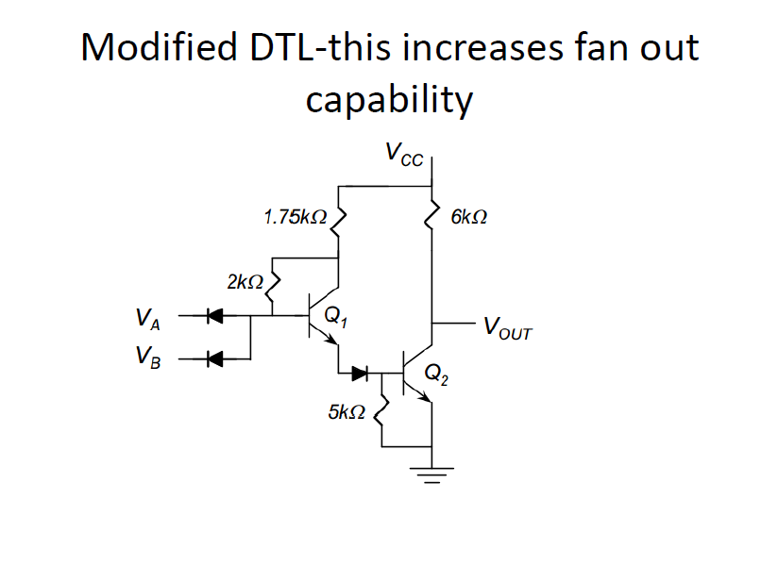

Slide 30
TTL
The original basic TTL gate was a slight improvement over the DTL gate.
There are several TTL subfamilies or series of the TTL technology.
first introduced by in 1964 (Texas Instruments)
TTL has shaped digital technology in many ways
Transistor alone performs the logical operation
Transistors operated in saturated mode.
Fastest of the saturated logic families
Good speed
Low manufacturing cost
Wide range of circuits
Availability in SSI & MSI
Relatively high power consumption

Slide 31
TTL(Transistor-Transistor Logic)
TTL subfamilies
Standard TTL
High speed TTL
Low power TTL
Schottky TTL
Low power Schottky TTL
Fast TTL
Three different types of output configurations:
open-collector output
Totem-pole output
Three-state (or tristate) output

Slide 32
TTL(Transistor-Transistor Logic)
The basic gate was constructed with different resistor value to produce gate with lower dissipation or higher speed.
The propagation delay of a saturated logic family depends largely on storage time and RC time constants.
Reduce the storage time decrease the propagation delay.
Reduce the resistor values in the circuit, decreases the time constant (RC) and decreases the propagation delay. But power dissipation is high due to lower resistance draw more current from the supply.
Speed of the gate is inversely proportional to propagation delay.
In low power TTL the resistor values are higher than standard TTL gate to reduce power dissipation, but increase propagation delay.
In high speed TTL resistor values are lowered to reduce the propagation delay but the power dissipation is increased.

Slide 33
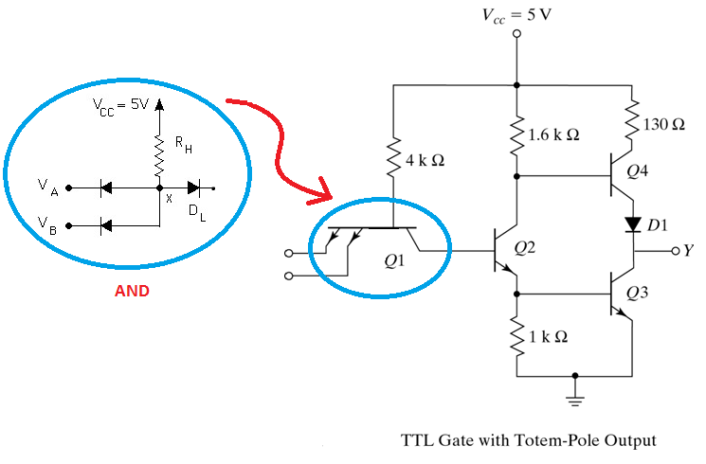
TTL Gate with Totem-Pole Output

Slide 34
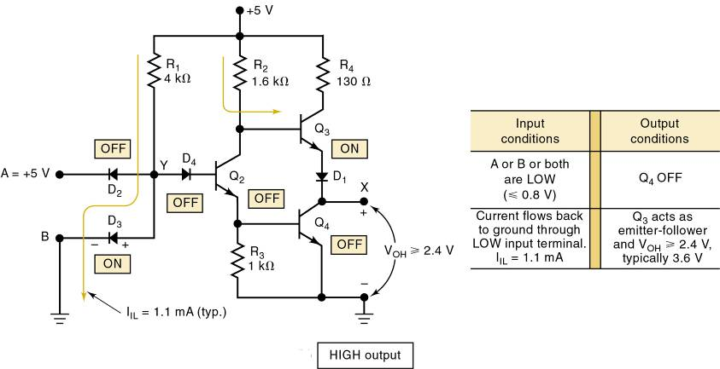

Slide 35
TTL Gate with Totem-Pole Output
o/p impedance of the gate normally resistive &capacitive loads.
Capacitive load consist of capacitance of o/p transistor, capacitance of fan-out gates and any stray wiring capacitances.
When o/p changes from low to high, the o/p transistor of the gate goes from saturation to cut-off and the total load capacitance ‘C’ charges from low to high with time constant RC.
For open collector gate Rl=4kohm, c=15pf ,tpd=35ns. With active pull-up is replaced by passive pull-up circuit tpd is reduced to 10ns. This is called totem pole output.
When o/p Y=low, Q2&Q3 are in saturation. VcQ2=Vbe(Q3)+Vce(Q2)=0.7+0.2=0.9v, Vce(Q3)=0.2V
Q4 is cut-off bcos base of Q4 require 2*0..6=1.2V.

Slide 36
TTL Gate with Totem-Pole Output
When o/p Y=high, one of the i/p drops to low ,Q2&Q3 are in cut-off. o/p remains low bcos the voltage across the load capacitance cannot change instantaneously. As soon as Q2 turns off Q4 conducts bcos base is connected to Vcc through 1.6Kohm.
The current needed to charge the load ‘ C’ causes Q4 to saturate, o/p voltage rises with time constant RC.
R=130ohm+Rsat(Q4)+Rd~=150ohm less compare to passive pull up resistor, so transition from low to high is faster.
When C charges ,o/p voltage rises and current in Q4 decreases so Q4 comes to active region. Final o/p=5v-Vbedrop in Q4-D1 drop=3.6v Q3 goes cut-off very fast. But initial transition Both Q3 &Q4 are on ,peak ct’ is drawn from the supply. This ct’ spikes generates noise.
Change of state is frequent current spikes increases and PD also increases.
Wired connection is not allowed.

Slide 37
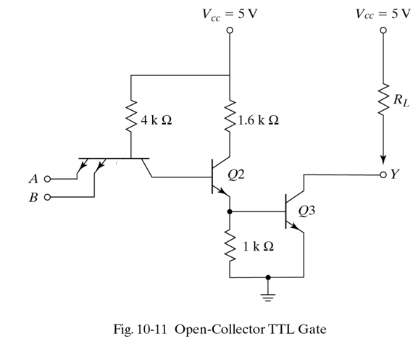
Open-collector TTL Gate

Slide 38
Open-collector TTL Gate
Multiple emitter of Q1 connected to i/ps. Compare to DTL ,i/p diodes--Q1, D1--B-C jn, D2—Q2.
o/p is taken from open collector of Q3.
Pull up resistor connected to Vcc, to pull up the o/p to high level when Q3 is off. Otherwise the o/p acts as an open circuit.
0.2v for low level,2.4 to 5v for high level.
If any i/p is low , corresponding B-E jn of Q1 is F.B. the voltage at base of Q1 is 0.9v(i/p 0.2+Vbe drop 0.7).
In order for Q3 to start conducting the path from Q1-Q3 must overcome the potential 1.8v (Diode drop in B-C jn drop+ two Vbe drop of Q2,Q3). But at Q1 is 0.9v so Q3 is cut-off , o/p is high.
If all i/ps are high Q2, Q3 conduct and saturate. B-E jns of Q1 are all R.B. when Q3 saturates o/p goes low to 0.2v.
Applications are driving a lamp or relay, performing wired logic and construction of common bus system

Slide 39
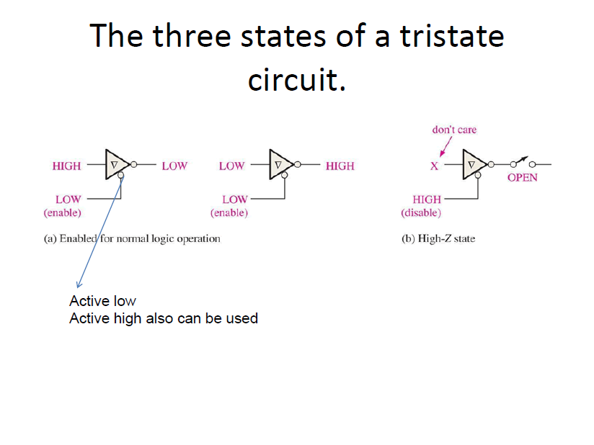

Slide 40
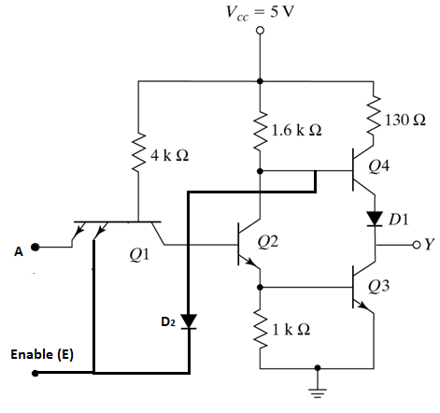
Three-state TTL with Inverter operation

Slide 41
Emitter-Coupled Logic (ECL)
Non saturated digital logic family & Used in high speed circuits
Propagation rate as low as 1-2ns
Noise immunity and power dissipation is high compare of all logic families.
Including
Differential input amplifier
Internal temperature and voltage compensated bias network
Emitter-follower outputs

Slide 42
ECL NOR / OR
The circuit has 2 outputs- inverting and non inverting output, input low is 3.6 V, input high is 4.4V.
When A=B=0, so Q1, Q2 are OFF, then Out1=High and Out2=Low.
When A=B=1, so Q1, Q2 are ON, then Out1= low and Out2=High.

Slide 43
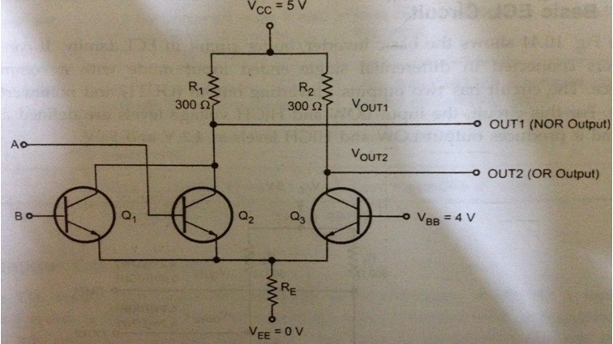
ECL (NOR/OR GATE)

Slide 44
Classes of Field Effect Transistors
Metal-Oxide-Semiconductor Field Effect Transistor
Which will be the type that we will study in this course.
Metal-Semiconductor Field Effect Transistor
MESFET
Junction Field Effect Transistor
JFET
High Electron Mobility Transistor or Modulation Doped Field Effect Transistor
HEMT or MODFET
Fast Reverse/Fast Recovery Epitaxial Diode
FREDFET
DNA Field Effect Transistor
The conduction path is through a strand of DNA

Slide 45
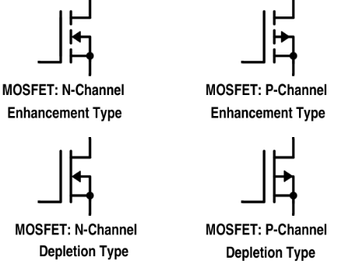
Types of MOSFETS

Slide 46
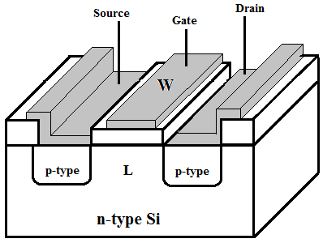
P-channel Enhancement Mode Transistor

Slide 47
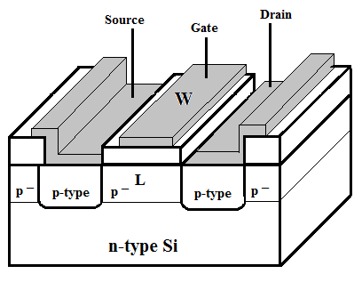
P-channel Depletion Mode Transistor

Slide 48
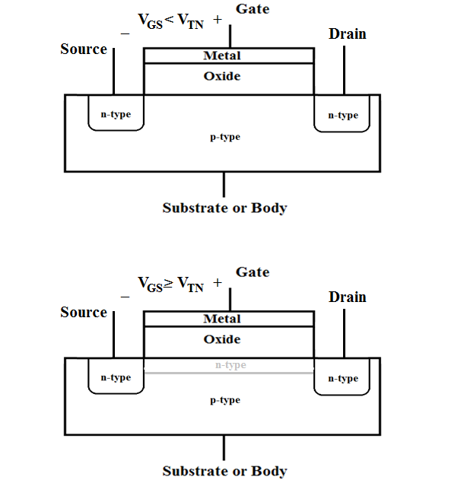
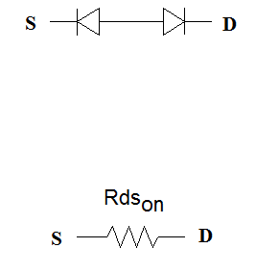
Before electron inversion layer is formed
After electron inversion layer is formed

Slide 49
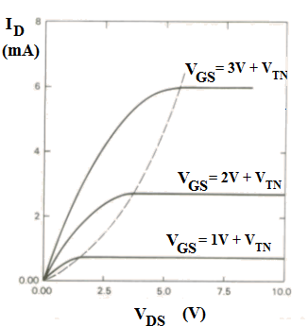
I_{D} Versus V_{DS} Curves Enhancement-Mode nMOSFET
Triode/
Nonsaturation
V_{DS} < V_{GS} – V_{TN}
V_{DS} > V_{GS} – V_{TN}
Pinch-off/Saturation
Cut-off V_{GS} < V_{TN}
Notes:
Enhancement Mode FETs are also known as Normally Off devices. Voltage must be applied to the Gate to allow current to flow between the Source and the Drain.

Slide 50
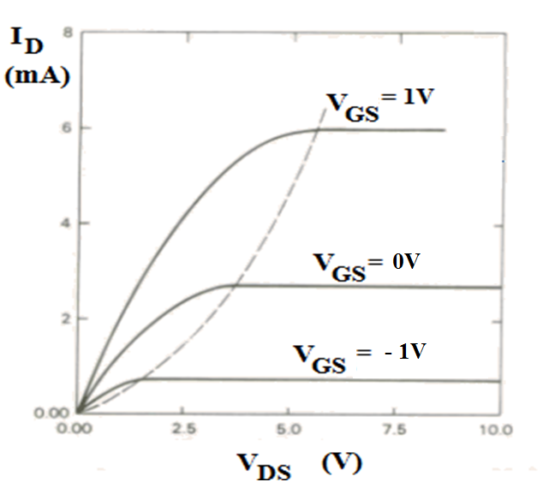
i_{D} Versus v_{DS} Curves Depletion-Mode nMOSFET
Assuming that V_{TN} < -1V
Notes:
Depletion Mode FETs are also known as Normally On devices. Voltage must be applied to the Gate to stop current from flowing between the Source and the Drain.

Slide 51
CMOS
Complimentary MOS (CMOS)
Other variants: NMOS, PMOS (obsolete)
Very low static power consumption
Scaling capabilities (large integration all MOS)
Full swing: rail-to-rail output
Things to watch out for:
don’t leave inputs floating (in TTL these will float to HI, in CMOS you get undefined behaviour)
susceptible to electrostatic damage (finger of death)
Open LTspice example: CMOS NOT and NAND…
Notes:
These also have lower power requirements than the standard TTL

Slide 52
CMOS power requirements
TTL power essentially constant (no frequency dependence)
CMOS power scales as ∝ f × C × V²
At high frequencies (>> MHz) CMOS dissipates more power than TTL
Overall advantage is still for CMOS even for very fast chips – only a relatively small portion of complicated circuitry operates at highest frequencies
frequency
supply volt.
eff. capacitance
Notes:
These also have lower power requirements than the standard TTL

Slide 53
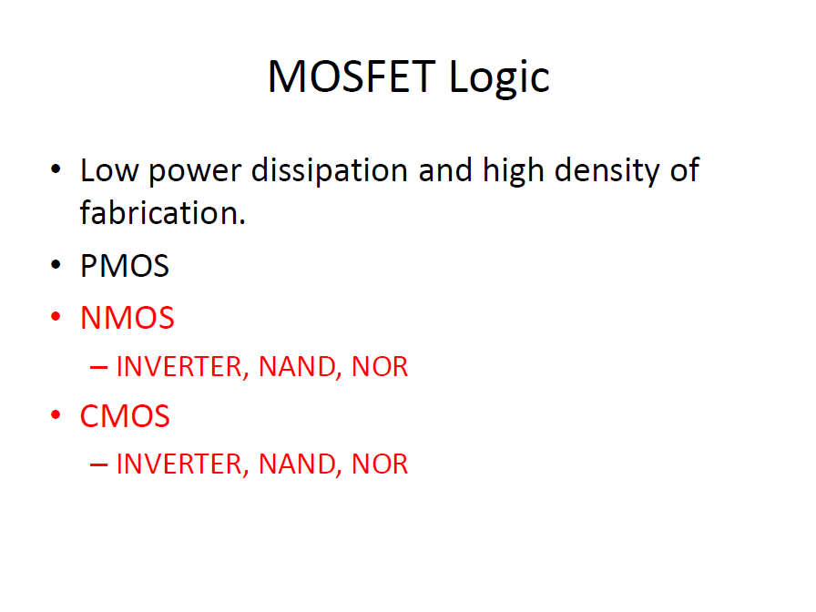

Slide 54
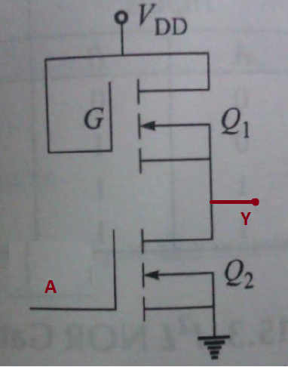
NMOS INVERTER (NOT)

Slide 55
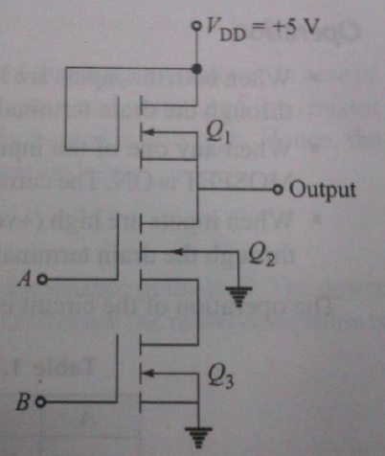
NMOS NAND

Slide 56
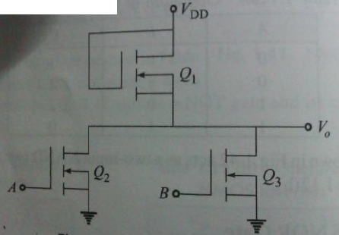
NMOS NOR

Slide 57
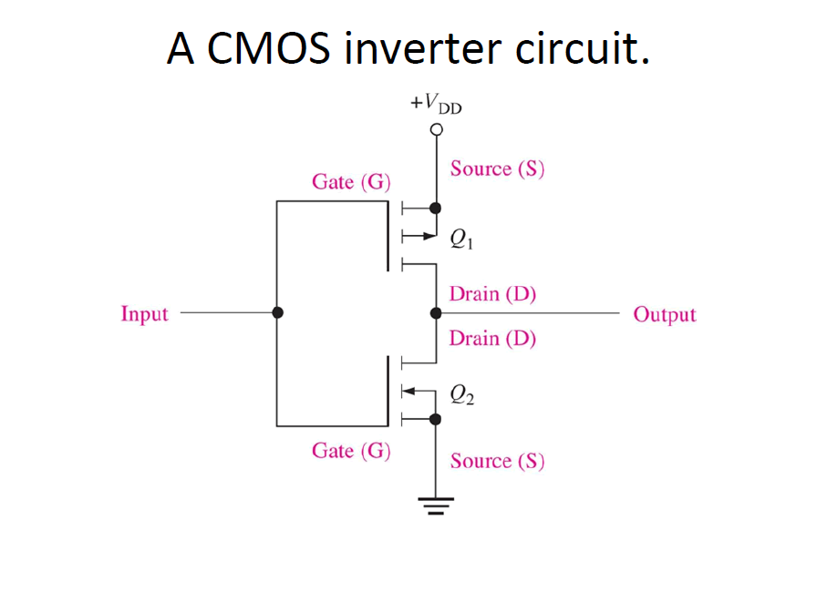

Slide 58
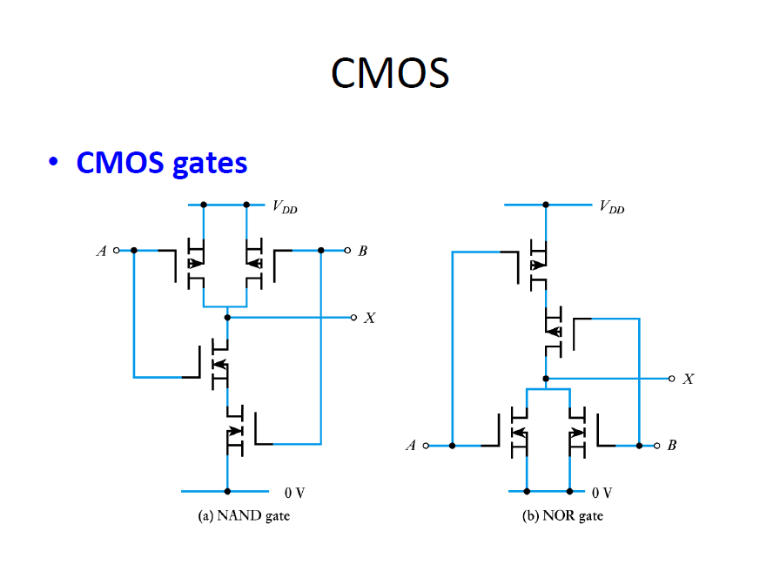

Slide 59
FPGA
A Field-Programmable Gate Array (FPGA) is an integrated circuit that can be configured by the user to emulate any digital circuit as long as there are enough resources.
The FPGA configuration is generally specified using a hardware description language (HDL)
An FPGA can be seen as an array of Configurable Logic Blocks (CLBs) connected through programmable interconnect (Switch Boxes).

Slide 60
FPGA structure

Slide 61
Simplified CLB Structure

